Slide 1
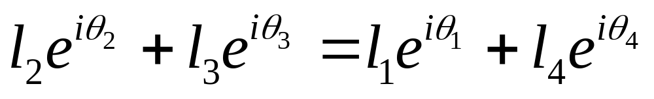
Position Analysis of a 4 bar RRRR Linkage Using Complex Numbers
Q
P
l₃
Im
l₅
θ₅
θ₃
l₄
l₂
θ₄
θ₂
l₁
θ₁
Re
O
Viewing the point P from two directions in the complex plane

Slide 2


Position Analysis of a 4 bar RRRR Linkage Using Complex Numbers
Q
P
l₃
Im
l₅
θ₅
θ₃
l₄
l₂
θ₄
θ₂
l₁
θ₁
Re
O
Separating the real
And the imaginary parts
We have two unknowns
And two scalar equations to solve for them

Slide 3
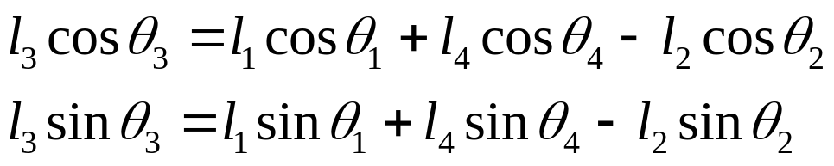
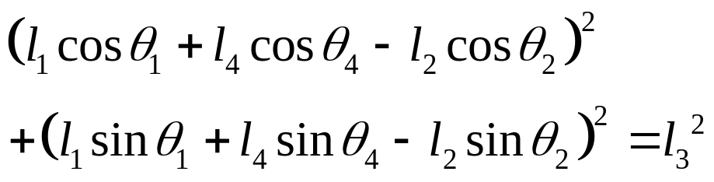
Position Analysis of a 4 bar RRRR Linkage Using Complex Numbers
Q
P
l₃
Im
l₅
θ₅
θ₃
l₄
l₂
θ₄
θ₂
l₁
θ₁
Re
O
Rearranging terms
Squaring and adding

Slide 4
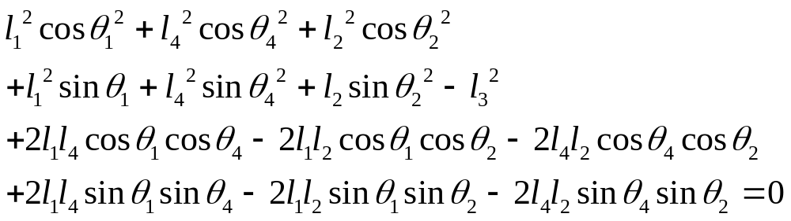
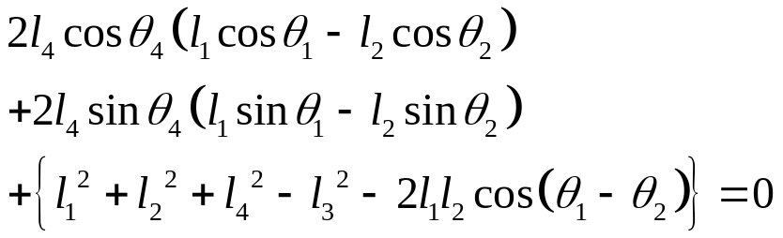
Position Analysis of a 4 bar RRRR Linkage Using Complex Numbers
Q
P
l₃
Im
l₅
θ₅
θ₃
l₄
l₂
θ₄
θ₂
l₁
θ₁
Re
O
Rearranging terms
Rearranging further

Slide 5
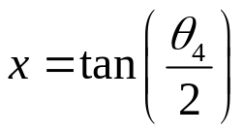
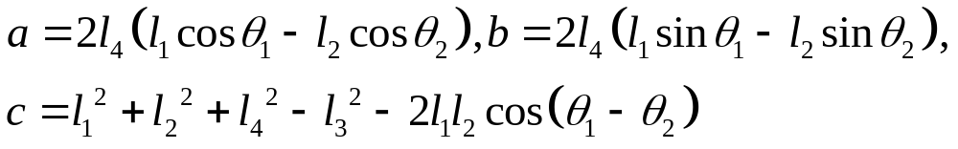
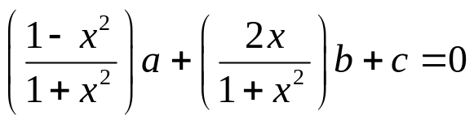
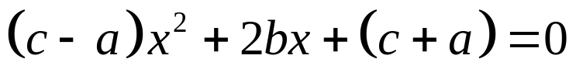
Position Analysis of a 4 bar RRRR Linkage Using Complex Numbers
Q
P
l₃
Im
l₅
θ₅
θ₃
l₄
l₂
θ₄
θ₂
l₁
θ₁
Re
O
Substitute
And
To get
Or

Slide 6
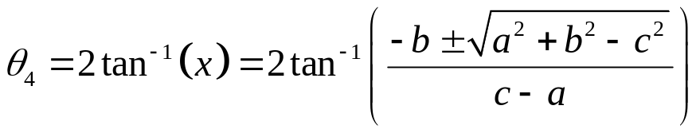
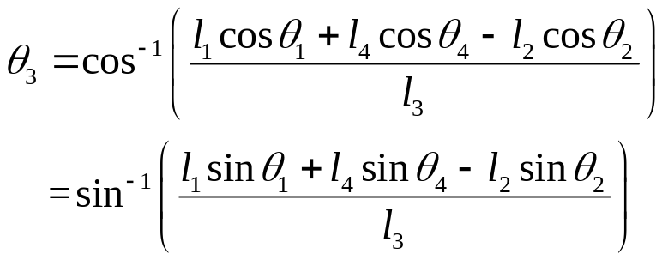
Position Analysis of a 4 bar RRRR Linkage Using Complex Numbers
Q
P
l₃
Im
l₅
θ₅
θ₃
l₄
l₂
θ₄
θ₂
l₁
θ₁
Re
O
Solving
we get two roots!
And
The signs of sinθ₃ and cosθ₃ will let us determine the quadrant in which θ₃ lies

Slide 7
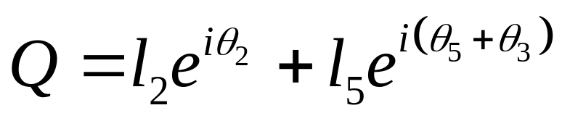
Position Analysis of a 4 bar RRRR Linkage Using Complex Numbers
Q
P
Im
l₅
θ₅
θ₃
l₄
l₂
θ₄
θ₂
θ₂
l₁
θ₁
Re
O
Now locate Q!

